Slide 1
Technical Services Overall Operations Review
June 2021

Slide 2
Cases Opened by Case Type vs Total Backlog

Slide 3
Cases Opened by Provider Group– June 2021

Slide 4
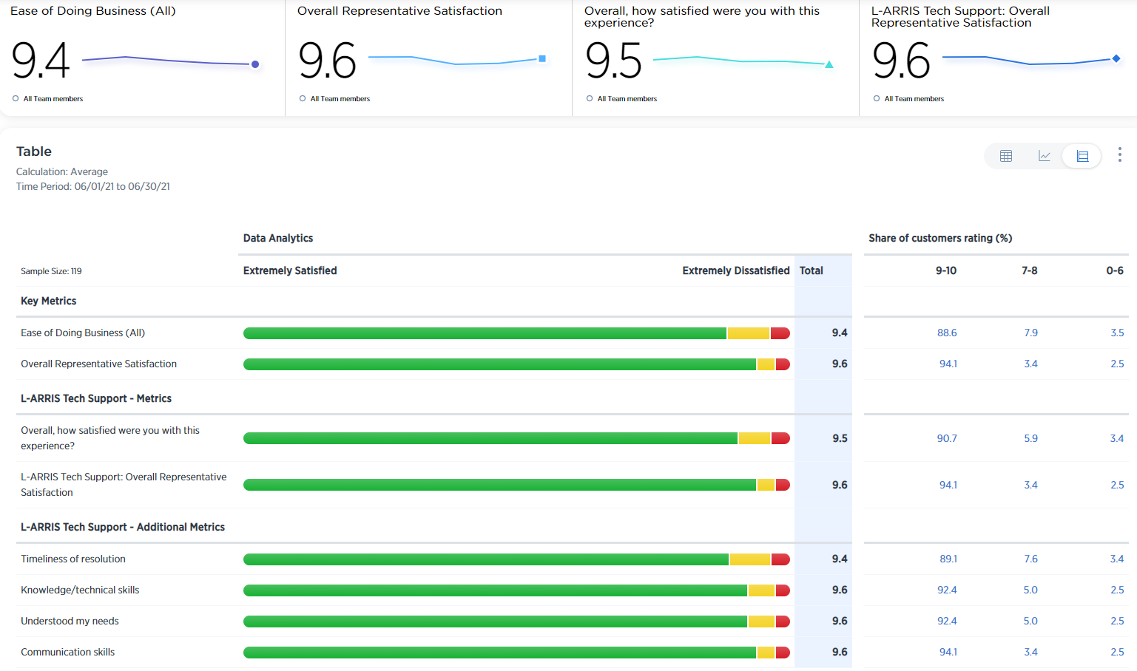
All Surveys June 2021

Slide 5
Cases Opened by Source – June 2021

Slide 6
S1 Cases by Company Sites – June 2021

Slide 7
Project Cases Opened vs Backlog and Aging Backlog – June 2021

Slide 8
Backup

Slide 9
Changes to Reporting Jan 2021
All cases and case types being reported as of Jan 2021
Previous reports excluded some cases and case types
Slide 2 – Backlog only shown for Jan 2021
Slide 2 – Case data for months prior to Jan 2021 was pulled separately and should be a close representation of activity in 2020
Slide 3 – Some Provider groups are combined to better represent Support Teams
Slide 5 – Bulk PMD cases were previously not reported, which accounts for the jump in automated case source
Slide 7 – Project case backlog drop at year end is expected as many projects are closed at year end

Slide 10
Case Type Definitions
Case Type | Definitions
Request | TAC quick cases, Documentation requests, Feature requests, PS Admin cases
Scheduled Maintenance | Proactive Activities Remote Services, Code download, Remote HW upgrades, Configuration changes Corrective Activities Scheduled Maintenance window
Project | Customer facing activities not related to a Technical Support issue Field Engineer support, service-oriented work, Deployment and implementation activities
Internal | For all internal activity and hours tracking
Customer Service | DOA cases, Shipment issues, credit returns
Return Material Auth | Return processing of defective equipment AR, Repair, Repair DOA, Customer inquiry or escalation post RMA creation
Bulk PMD | Auto-generated and submitted cases used by CMTS support team for PMD analysis Response not expected by customer, Converted to TS case if action needed
PMD | Customer submits PMD directly via portal to create case Customer expects a response
Technical Support | For requests for technical assistance or information. Should be used for any restorative activity

